Slide 1

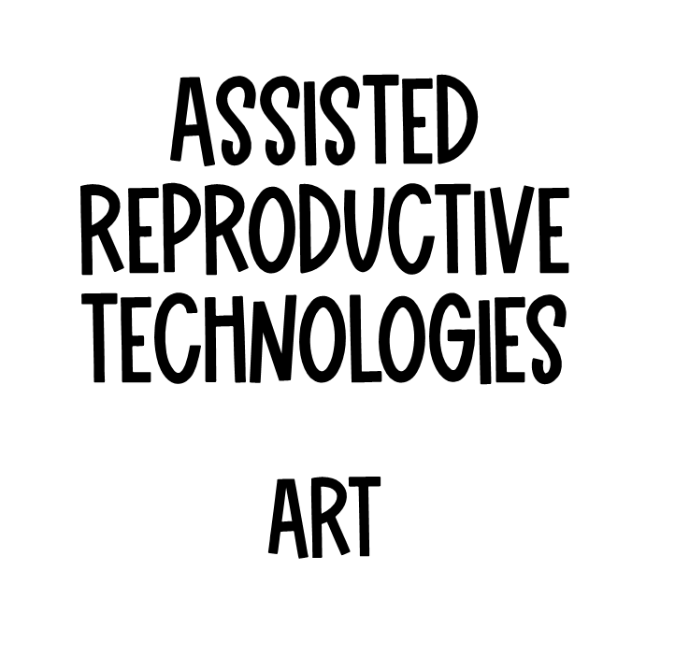
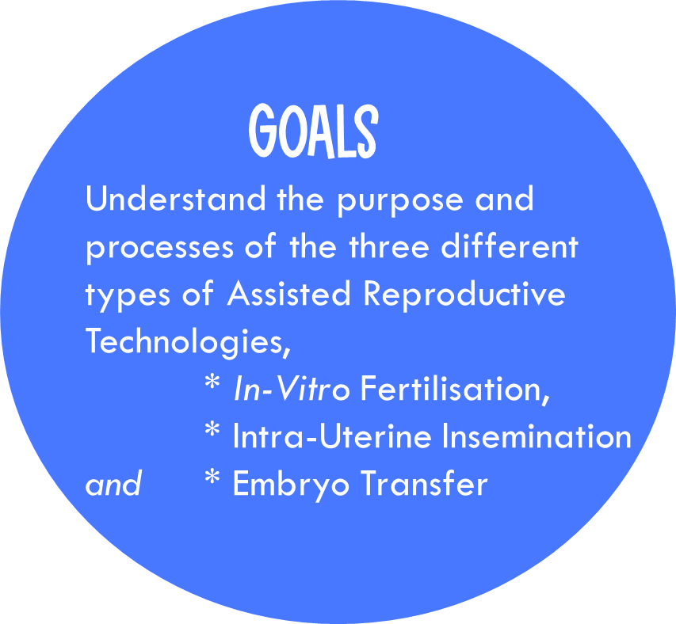

Slide 2








Read
View
Notes
To Do
Stop at 3.30

Slide 3

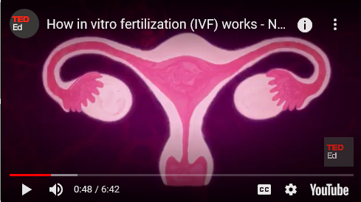



1. What is the purpose of the FSH hormone?
Prepares the uterus for a fertilised egg
Ripens a few follicles in the ovaries
To release the egg from the ovary
Start menstruation.
Read
View
Notes
2. How many follicles become fully mature in a normal monthly cycle?
One
Two
Three
More than three.
3. Which hormone is necessary to then maintain a pregnancy?
Oestrogen
Progesterone
FSH
LH
To Do

Slide 4
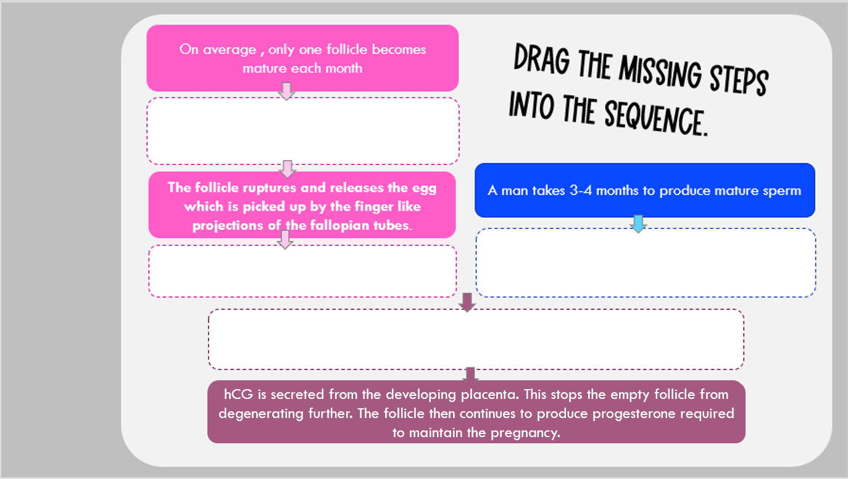



Read
View
Notes
The follicle makes oestrogen, which when in high enough levels, the brain releases LH, which triggers ovulation. .
Each ejaculation releases more than 100 million sperm, but only 100 make it to the egg, and only one is needed to fertilise the egg.
It takes about 3 days for the egg to reach the uterus, and another 3 days to implant into the inner lining.
To Do
The egg must be fertilised by sperm within 24 hours of ovulation.

Slide 5










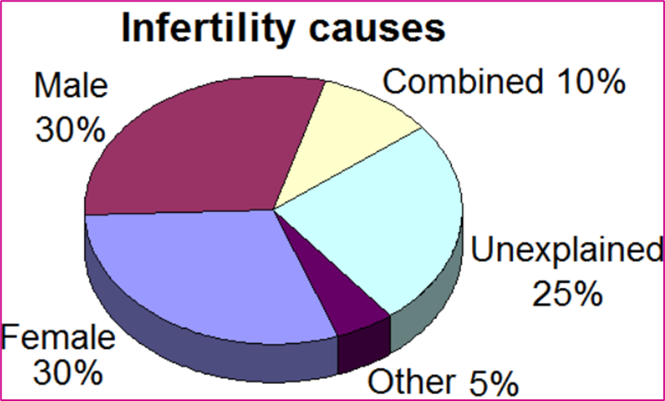

Main factors affecting infertility for a woman…
Ovulatory (eg when a woman does not release an egg every month; poor egg quality)
Tubal - tubal blockage (eg STI’s / Pelvic Endometriosis)
Age
Main factors affecting infertility for a male…
Semen:
volume concentration,
motility,
morphology
Read
Read
View
View
15% of Australian couples will have infertility problems.
(May 2018, Health Direct)
Notes
Infertility is the inability to conceive or sustain a pregnancy.
To Do

Slide 6


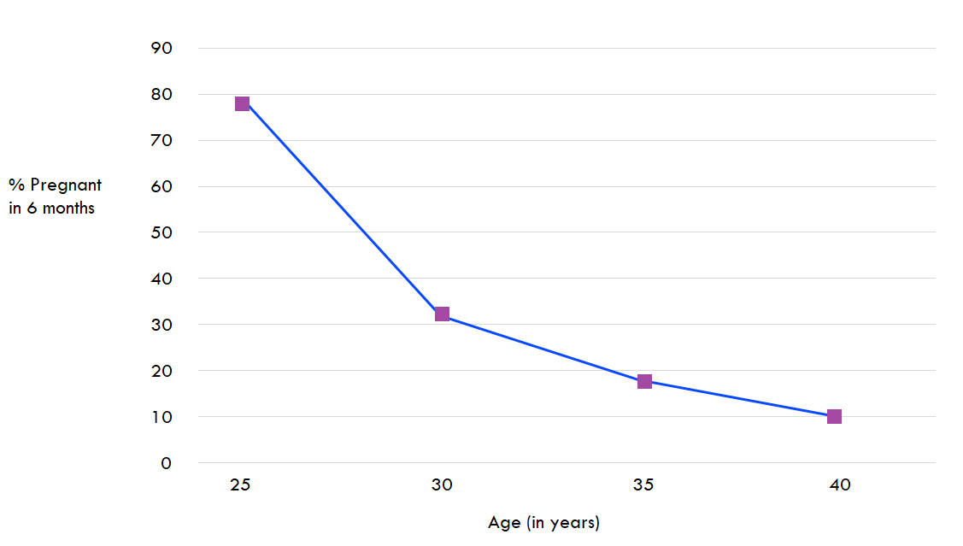
FEMALE AND MALE FERTILITY DECREASE WITH AGE.
For women fertility starts to slowly decline when they are in their early thirties. Around age 35 the decline speeds up and by age 40 the chance of conceiving has fallen by half. The biological reason for this is…
As women age, the total number of eggs in their ovaries and their quality decline.
The average age of menopause is about 51 years (and this has not changed over the centuries) and this marks the absolute end of fertility
It is rare for a woman to conceive in the 10 years leading up to menopause.
At age 40 about 75% of eggs are chromosomally abnormal which reduces the chance of pregnancy and increases the risk of miscarriage
Read
View
Notes
To Do

Slide 7

Using the information in the graph, explain how age affects the percentage of women who are able to fall pregnant within the first 6 months of trying.
Read
Fertility decreases with age.
View
Notes
To Do

Slide 8
In a sentence or two, compare these numbers using your own words.
Risk of Chromosomal Abnormalities at Live Birth, According to Maternal Age.
Maternal Age at Delivery (year) | Risk of Chromosomal Abnormality
20 | 1/256
25 | 1/476
30 | 1/385
35 | 1/192
40 | 1/66
45 | 1/21
Read
View
Notes
To Do

Slide 9
Read
View
Notes
To Do

Slide 10



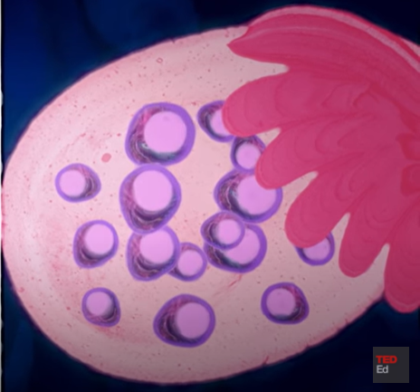
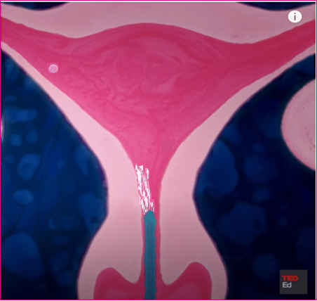
Surgery (not discussed)
Ovulation induction
Intra - uterine insemination
In-vitro fertilisation.
Read
The goal is to stimulate egg production, and monitor in order to maximise success of a single pregnancy.
Injections of FSH given to increase
number of eggs produced.
Ovulation monitored.
Normal fertilisation occurs or
Intra-uterine insemination is used
at time of ovulation.
View
Notes
To Do

Slide 11
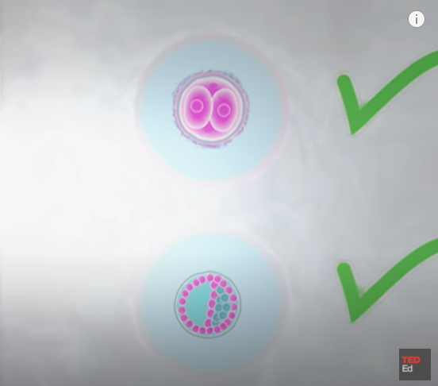


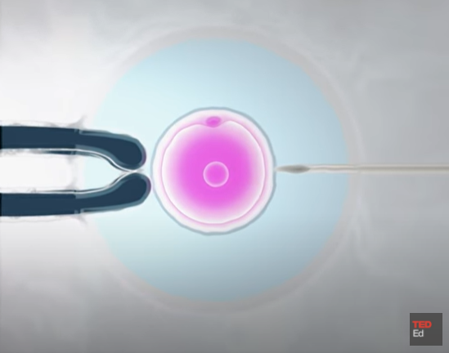
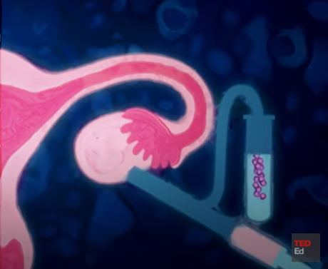
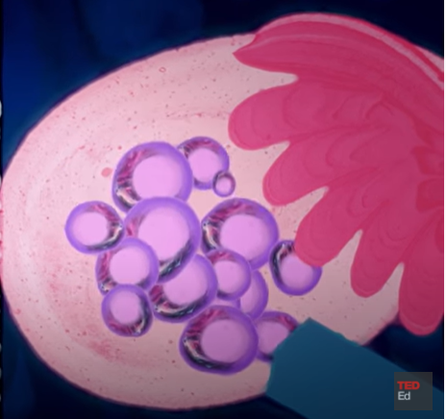
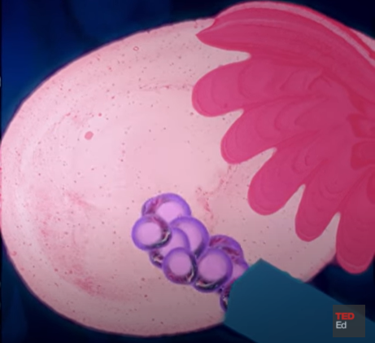

Read
Read
Goal is to find the single best embryo in order to maximise success of a single pregnancy.
Egg production is stimulated.
Eggs are collected.
External fertilisation occurs.
Embryo is screened.
Embryo is transferred back into uterus.
View
Notes
To Do

Slide 12


Infertility problems happen on an average to 1 in 8 couples. How would the following affect the ability to conceive a child, and which ART would you recommend?
1. A 39 year old female is trying to conceive and cannot fall pregnant.
3. A 28 year old female has blocked fallopian tubes.
2. A male has a low sperm count.

